Slide 1
Data Structure - Queues
Prepared By Mr . Venkatesh H

Slide 2
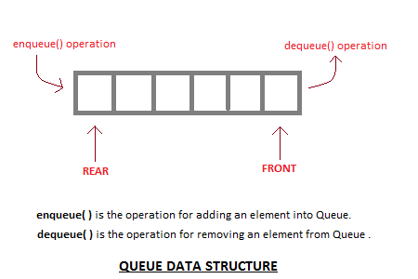
Queues
Queue is an abstract data structure, somewhat similar to Stacks. Unlike stacks, a queue is open at both its ends. One end is always used to insert data (enqueue) and the other is used to remove data (dequeue).

Slide 3

Queue
Queue follows First-In-First-Out methodology, i.e., the data item stored first will be accessed first.
A real-world example of queue can be a single-lane one-way road, where the vehicle enters first, exits first.

Slide 4
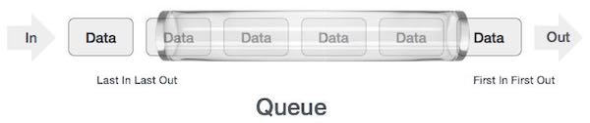
Queue Representation
As we now understand that in queue, we access both ends for different reasons. The following diagram given below tries to explain queue representation as data structure −
As in stacks, a queue can also be implemented using Arrays, Linked-lists, Pointers and Structures.

Slide 5
Basic Operations
Queue operations may involve initializing or defining the queue, utilizing it, and then completely erasing it from the memory. Here we shall try to understand the basic operations associated with queues −
enqueue() − add (store) an item to the queue.
dequeue() − remove (access) an item from the queue.
Few more functions are required to make the above-mentioned queue operation efficient. These are −
peek() − Gets the element at the front of the queue without removing it.
isfull() − Checks if the queue is full.
isempty() − Checks if the queue is empty.
In queue, we always dequeue (or access) data, pointed by front pointer and while enqueing (or storing) data in the queue we take help of rear pointer.

Slide 6
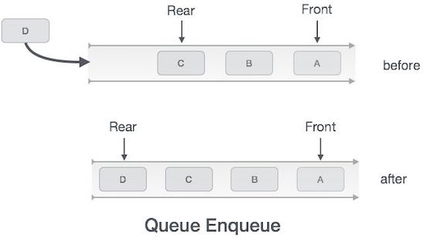
Enqueue Operation
Queues maintain two data pointers, front and rear. Therefore, its operations are comparatively difficult to implement than that of stacks.
The following steps should be taken to enqueue (insert) data into a queue −
Step 1 − Check if the queue is full.
Step 2 − If the queue is full, produce overflow error and exit.
Step 3 − If the queue is not full, increment rear pointer to point the next empty space.
Step 4 − Add data element to the queue location, where the rear is pointing.
Step 5 − return success.

Slide 7
Algorithm for enqueue operation
procedure enqueue(data)
if queue is full
return overflow
endif
rear ← rear + 1
queue[rear] ← data
return true
end procedure

Slide 8
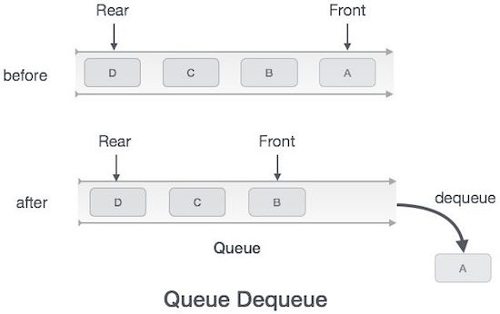
Dequeue Operation
Accessing data from the queue is a process of two tasks − access the data where front is pointing and remove the data after access. The following steps are taken to perform dequeue operation −
Step 1 − Check if the queue is empty.
Step 2 − If the queue is empty, produce underflow error and exit.
Step 3 − If the queue is not empty, access the data where front is pointing.
Step 4 − Increment front pointer to point to the next available data element.
Step 5 − Return success.

Slide 9
Algorithm for dequeue operation
procedure dequeue
if queue is empty
return underflow
end if
data = queue[front]
front ← front + 1
return true
end procedure

Slide 10
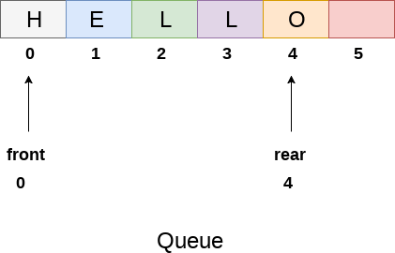
Array representation of queue
We can easily represent queue by using linear arrays. There are two variables i.e. front and rear, that are implemented in the case of every queue. Front and rear variables point to the position from where insertions and deletions are performed in a queue. Initially, the value of front and queue is -1 which represents an empty queue.

Slide 11
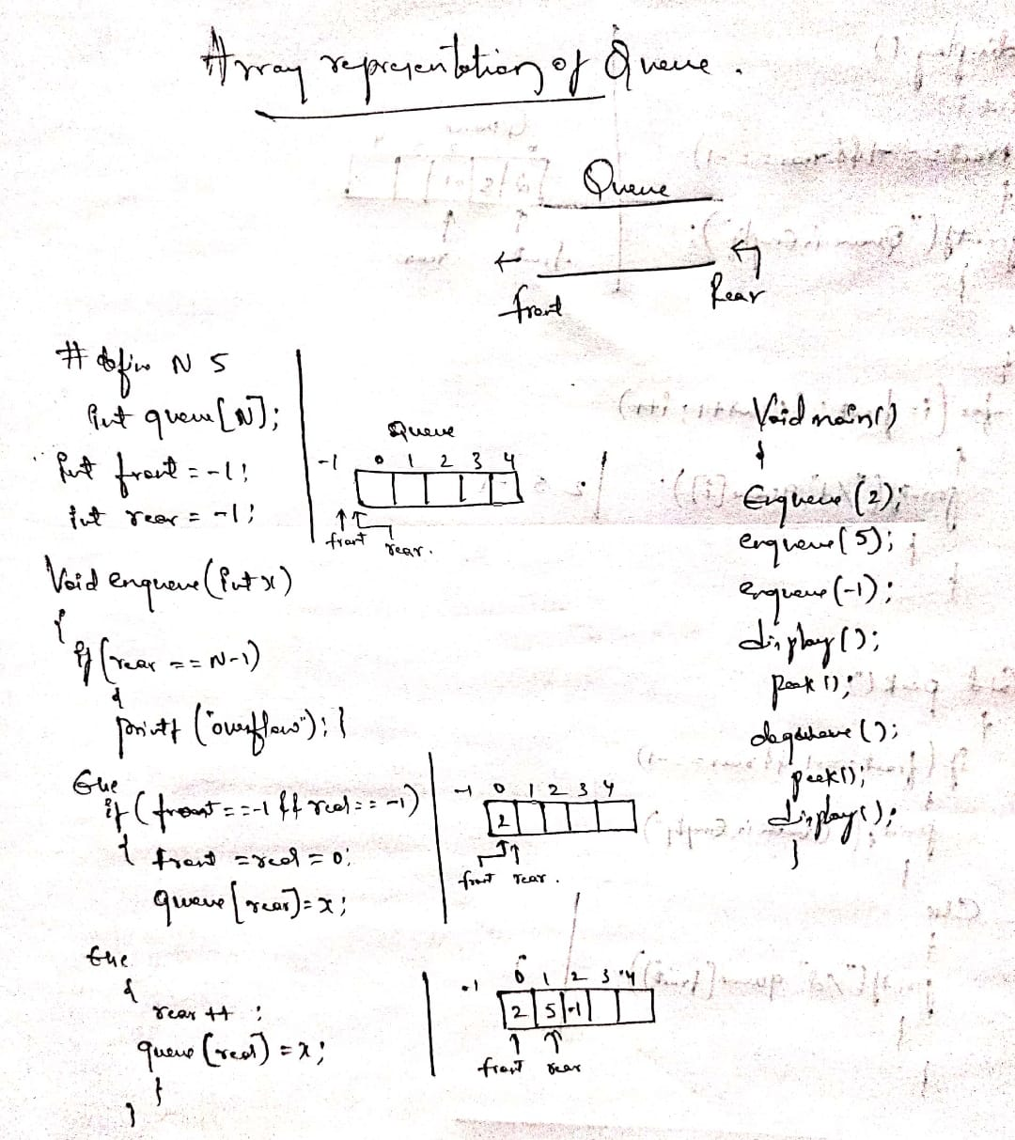
Array representation of queue

Slide 12
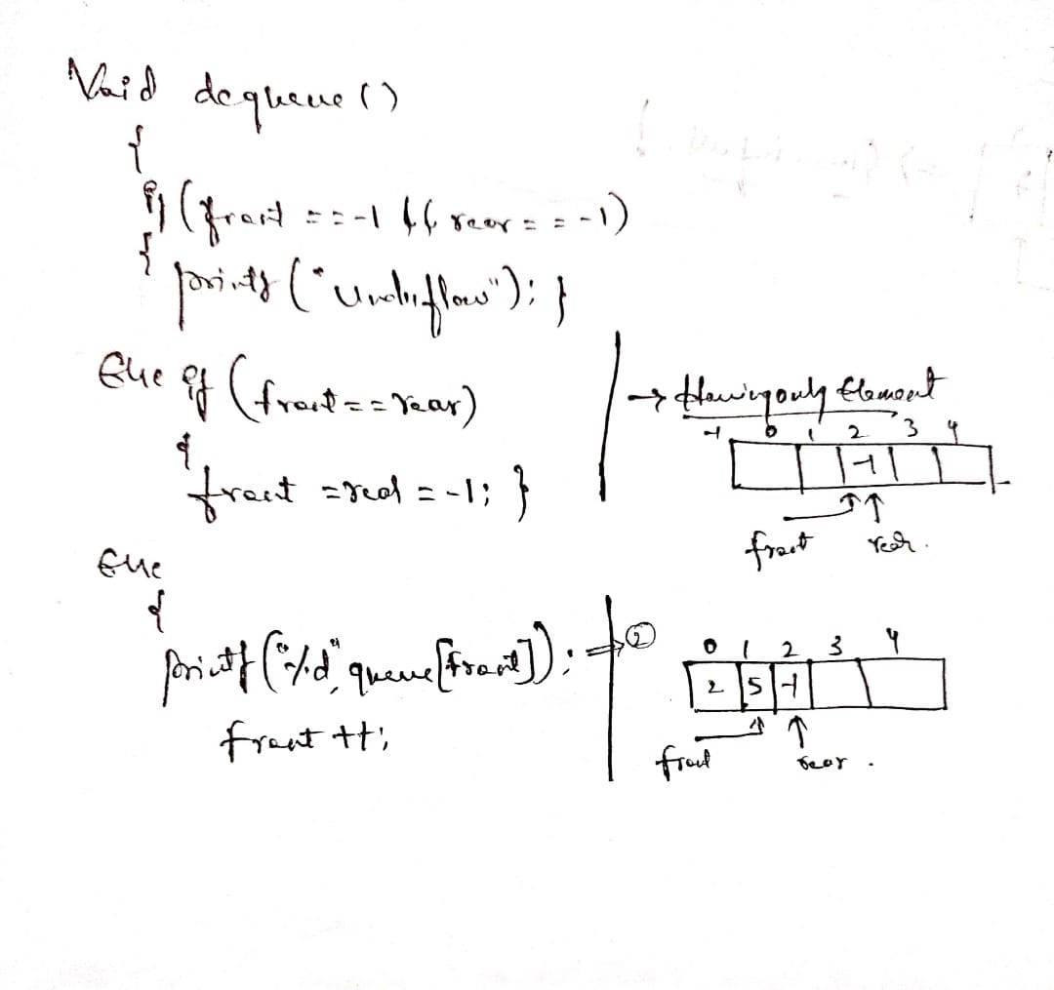
Continue…

Slide 13
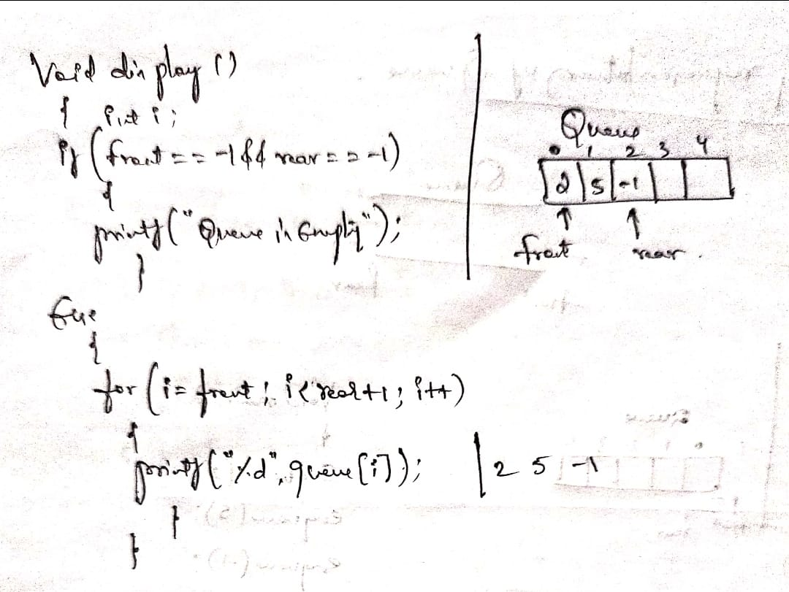
Continue…

Slide 14
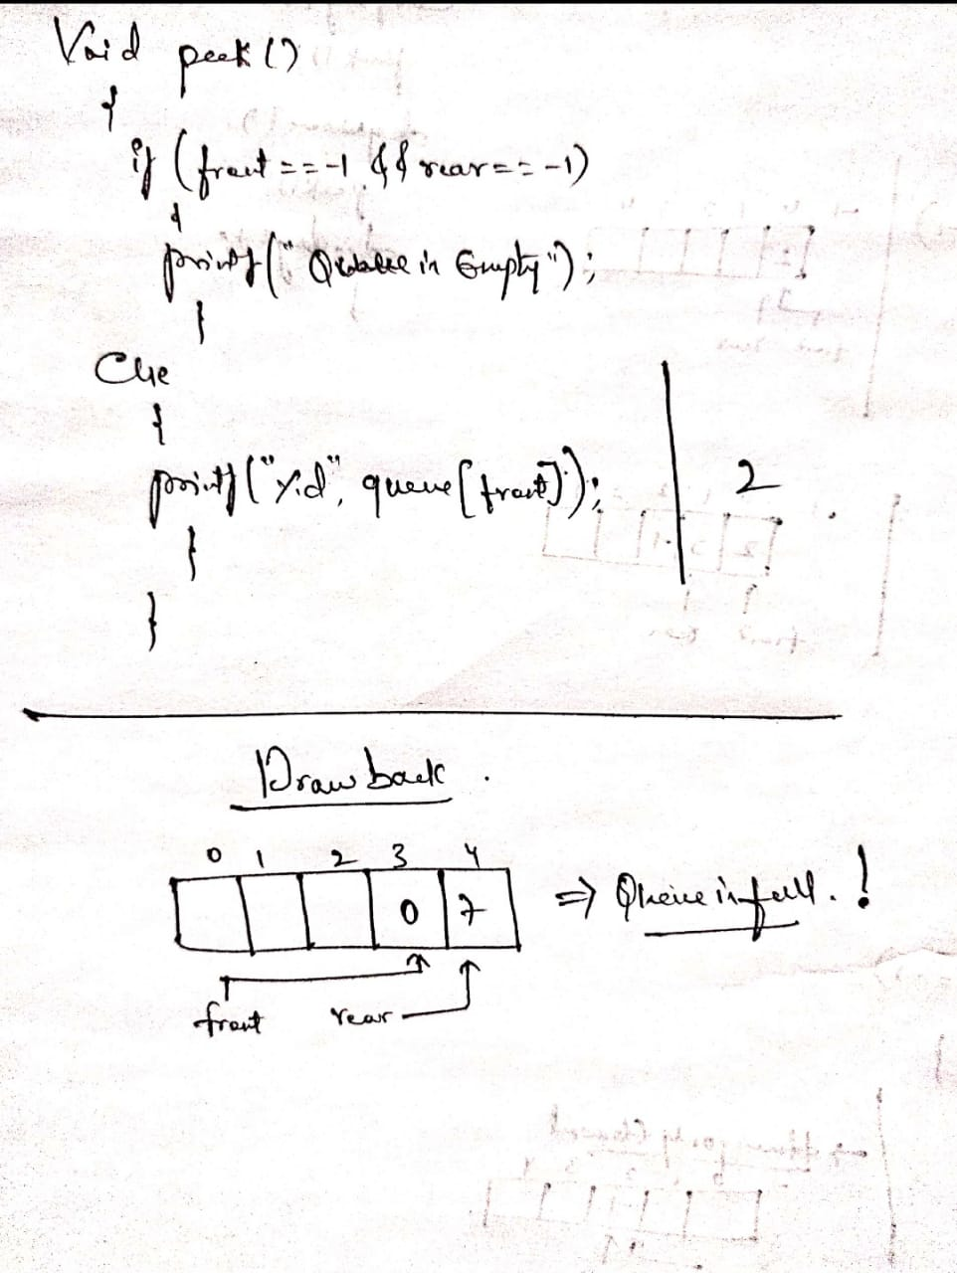
Continue…

Slide 15
linked list representation of queue
Due to the drawbacks discussed in the previous section of this tutorial, the array implementation can not be used for the large scale applications where the queues are implemented. One of the alternative of array implementation is linked list implementation of queue.
In a linked queue, each node of the queue consists of two parts i.e. data part and the link part. Each element of the queue points to its immediate next element in the memory.

Slide 16
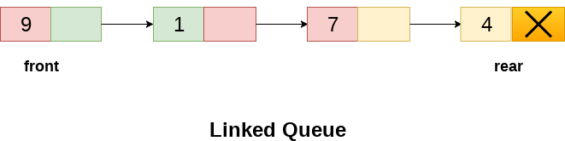
Continue…
Insertion and deletions are performed at rear and front end respectively. If front and rear both are NULL, it indicates that the queue is empty.
The linked representation of queue is shown in the following figure.

Slide 17
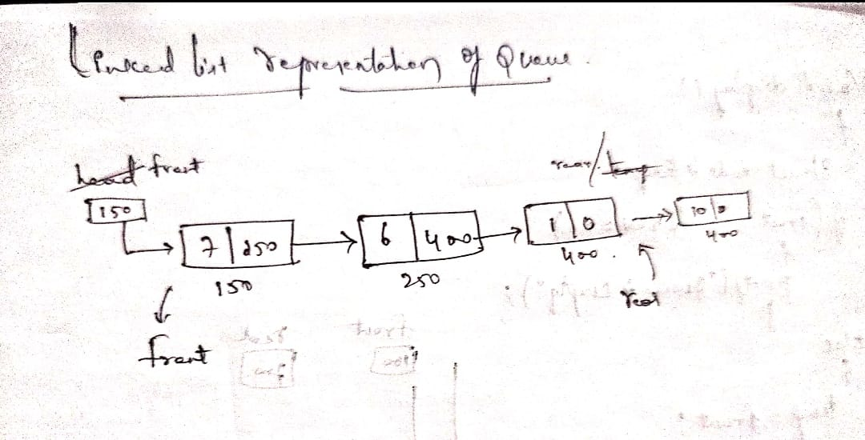
Continue…

Slide 18
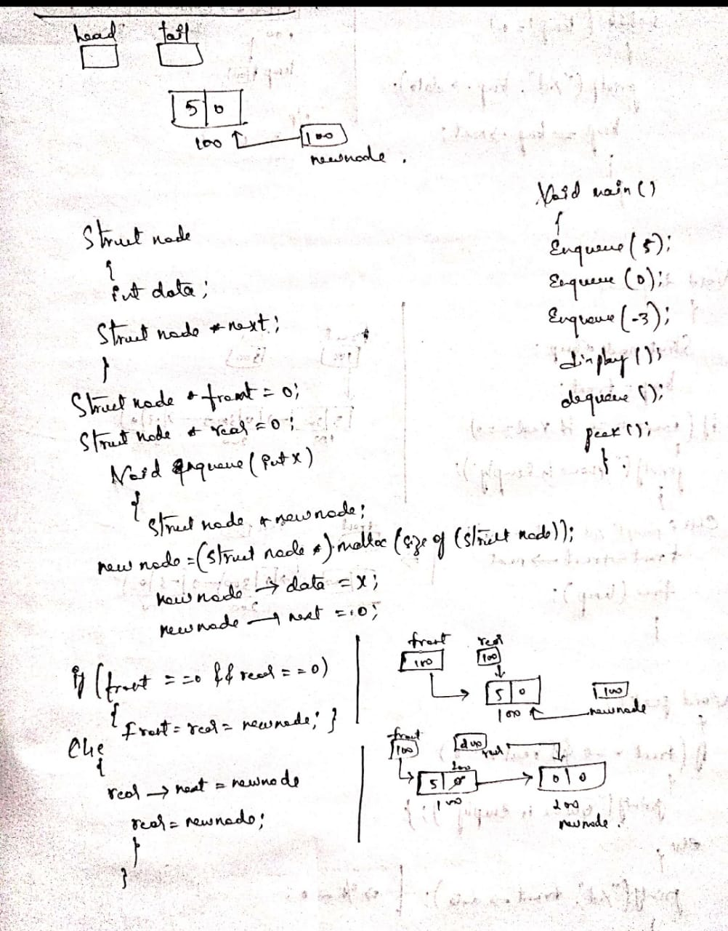
Continue…

Slide 19
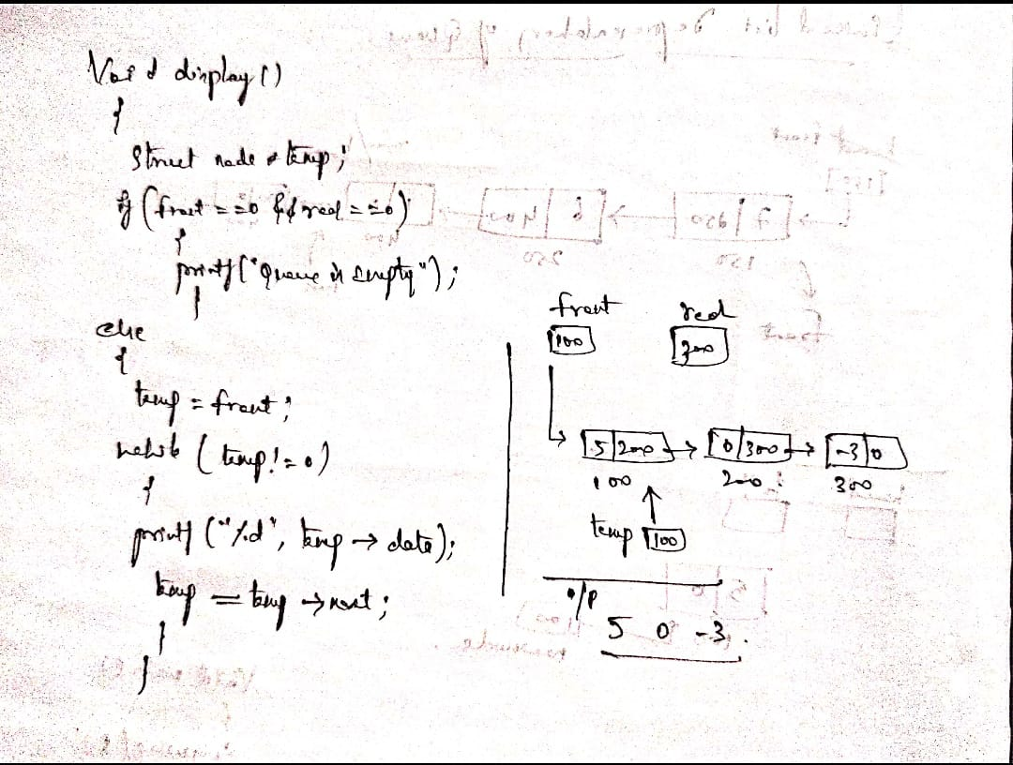
Continue…

Slide 20
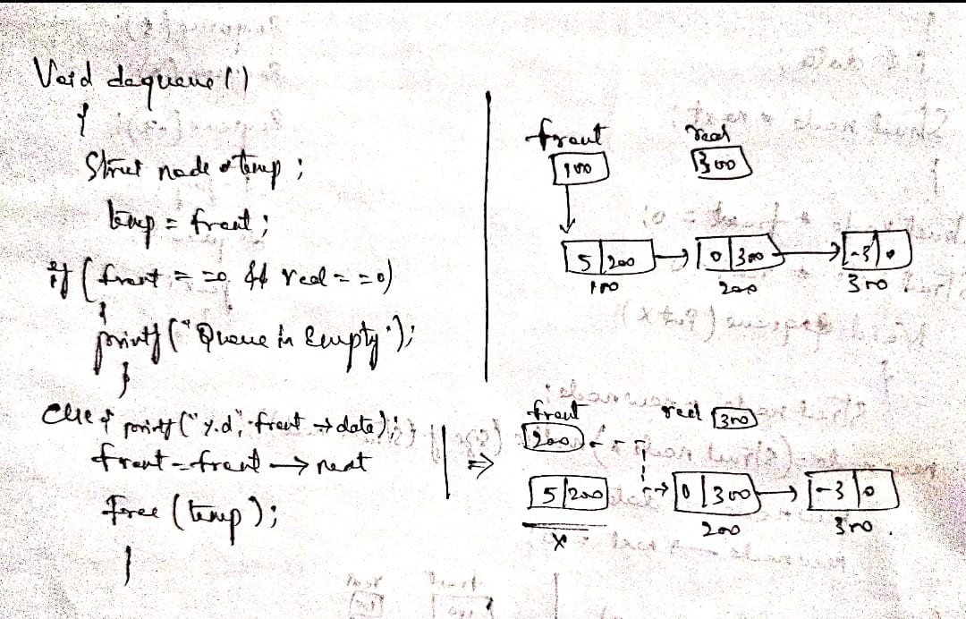
Continue…

Slide 21
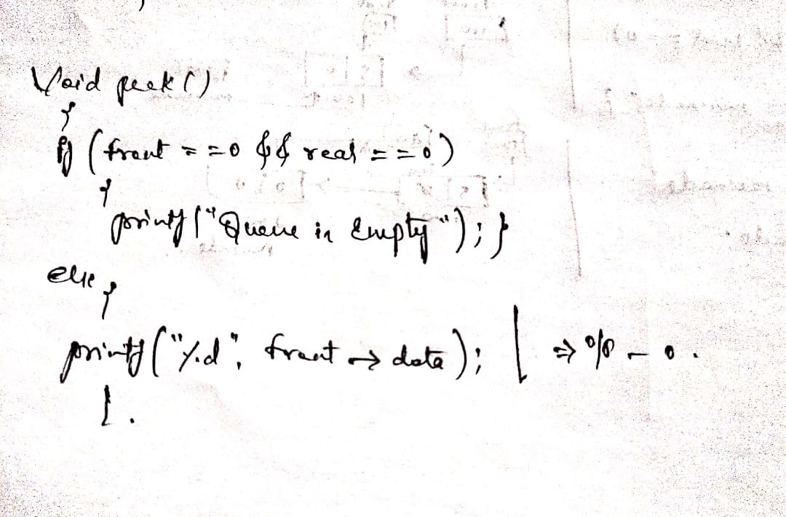
Continue…

Slide 22
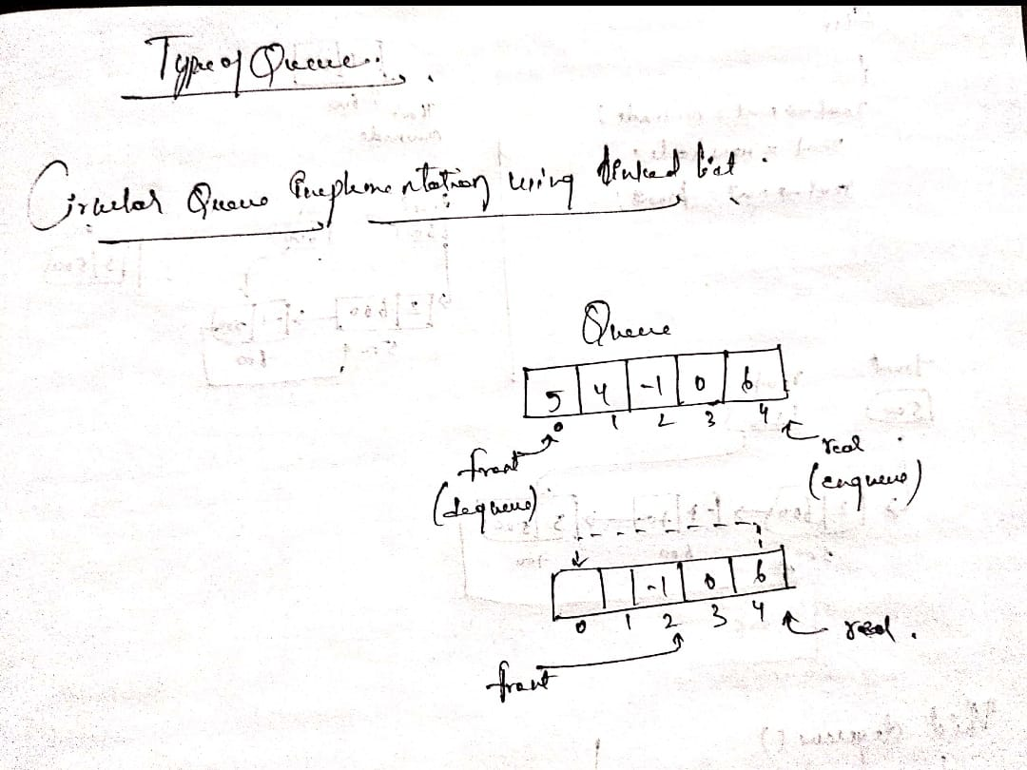
Types of Queues

Slide 23
Types of Queues
Queue in data structure is of the following types
Simple Queue
Circular Queue
Priority Queue
Dequeue (Double Ended Queue)

Slide 24

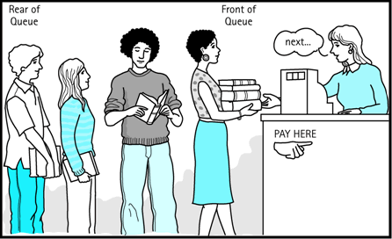
Simple queue
Simple queue defines the simple operation of queue in which insertion occurs at the rear of the list and deletion occurs at the front of the list.

Slide 25
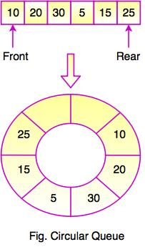

Circular Queue
In a circular queue, all nodes are treated as circular. Last node is connected back to the first node.
Circular queue is also called as Ring Buffer.
It is an abstract data type.
Circular queue contains a collection of data which allows insertion of data at the end of the queue and deletion of data at the beginning of the queue.
The figure shows the structure of circular queue. It stores an element in a circular way and performs the operations according to its FIFO structure.

Slide 26
Continue…
This queue is primarily used in the following cases:
Memory Management: The unused memory locations in the case of ordinary queues can be utilized in circular queues.
Traffic system: In a computer-controlled traffic system, circular queues are used to switch on the traffic lights one by one repeatedly as per the time set.
CPU Scheduling: Operating systems often maintain a queue of processes that are ready to execute or that are waiting for a particular event to occur.

Slide 27
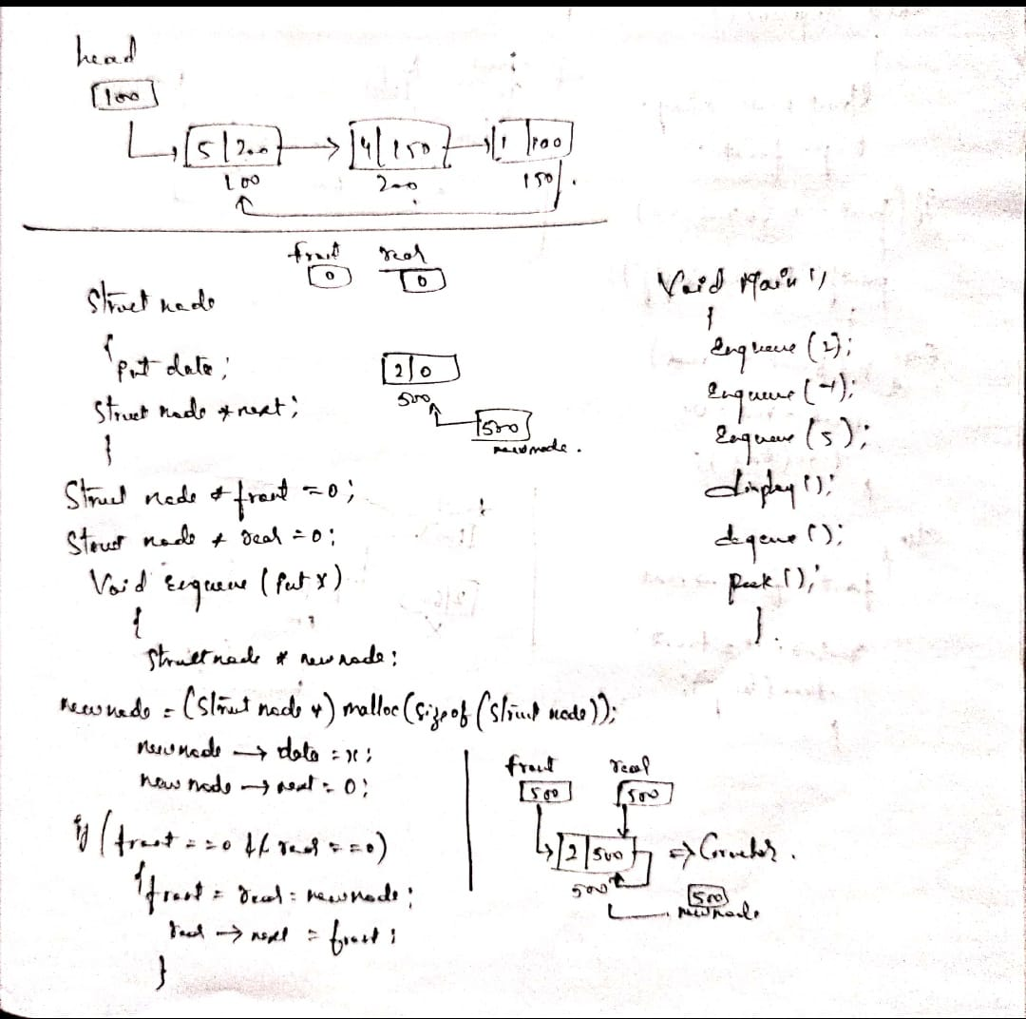
Circular queue implementation using linked list

Slide 28
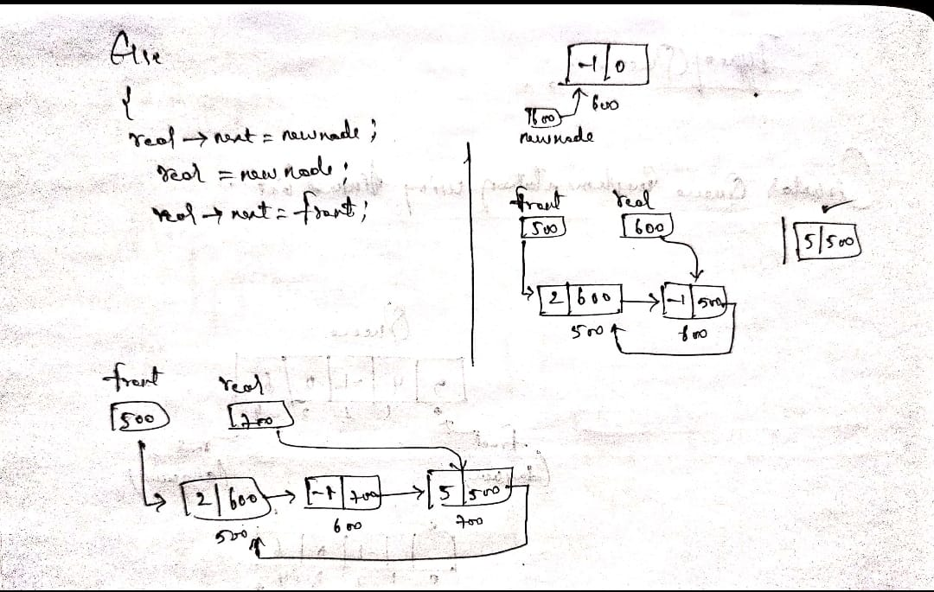
Continue…

Slide 29
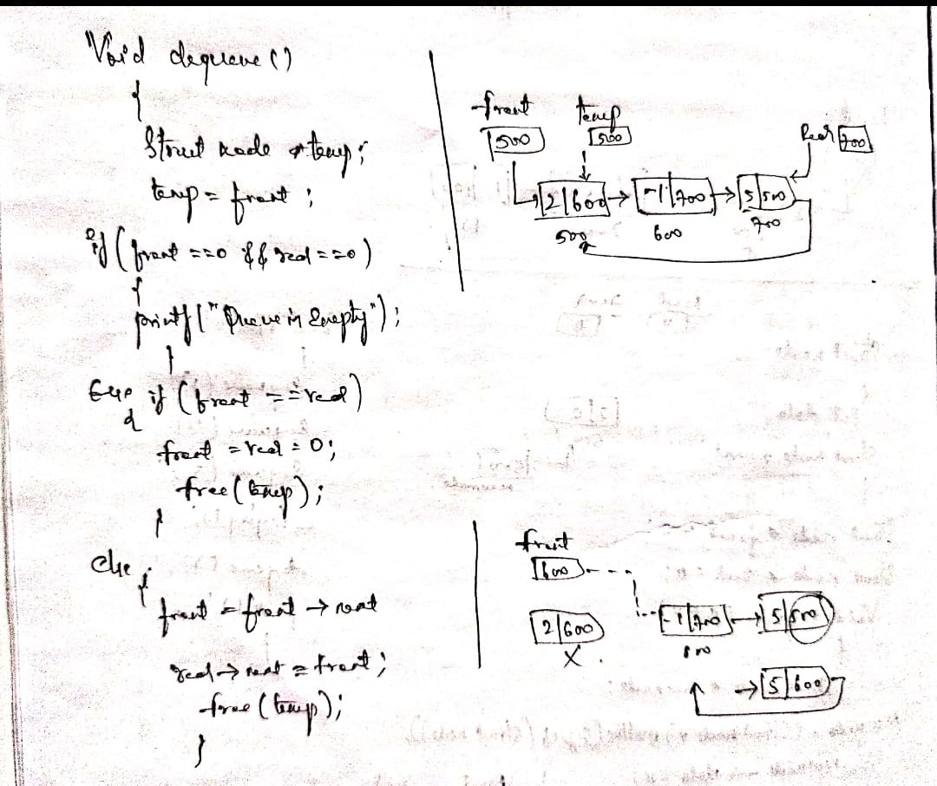
Continue…

Slide 30
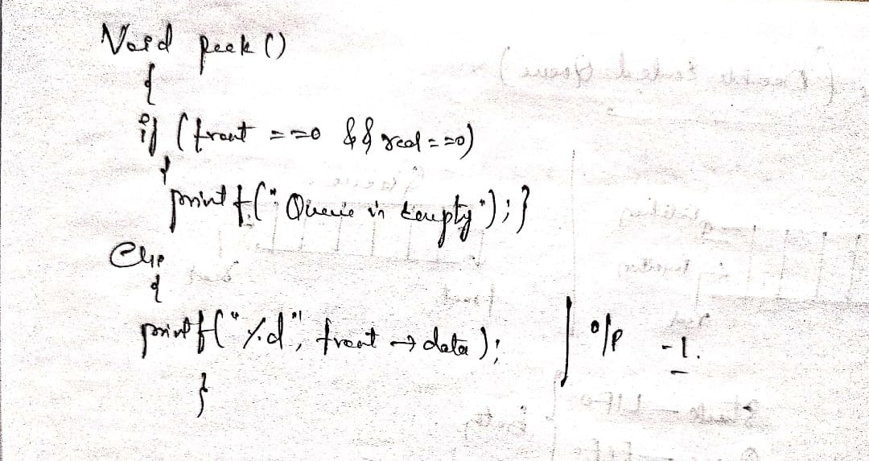
Continue…

Slide 31
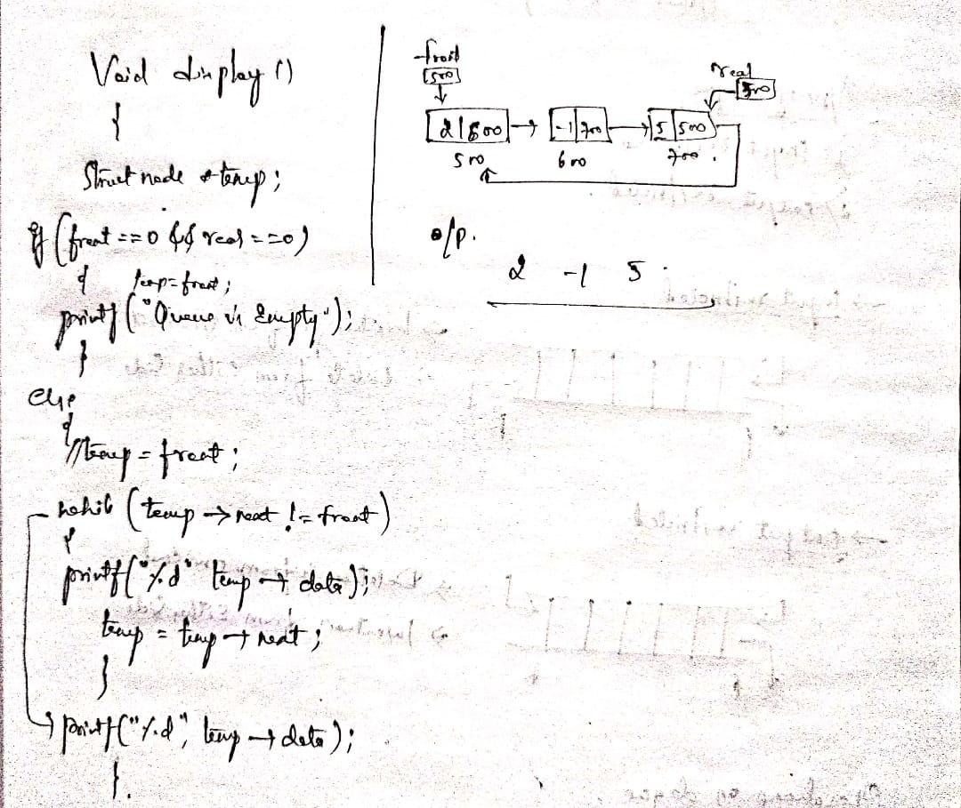
Continue…

Slide 32
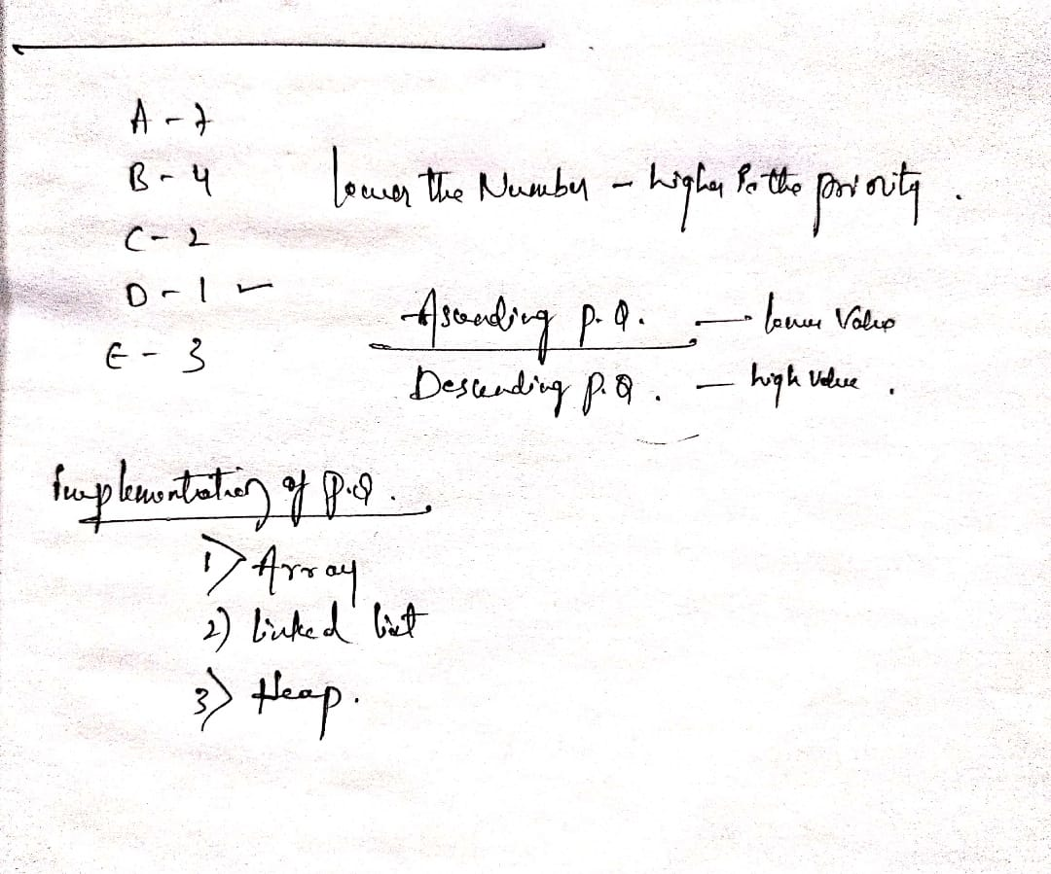
Priority Queue
Priority queue contains data items which have some preset priority. While removing an element from a priority queue, the data item with the highest priority is removed first.
In a priority queue, insertion is performed in the order of arrival and deletion is performed based on the priority.

Slide 33
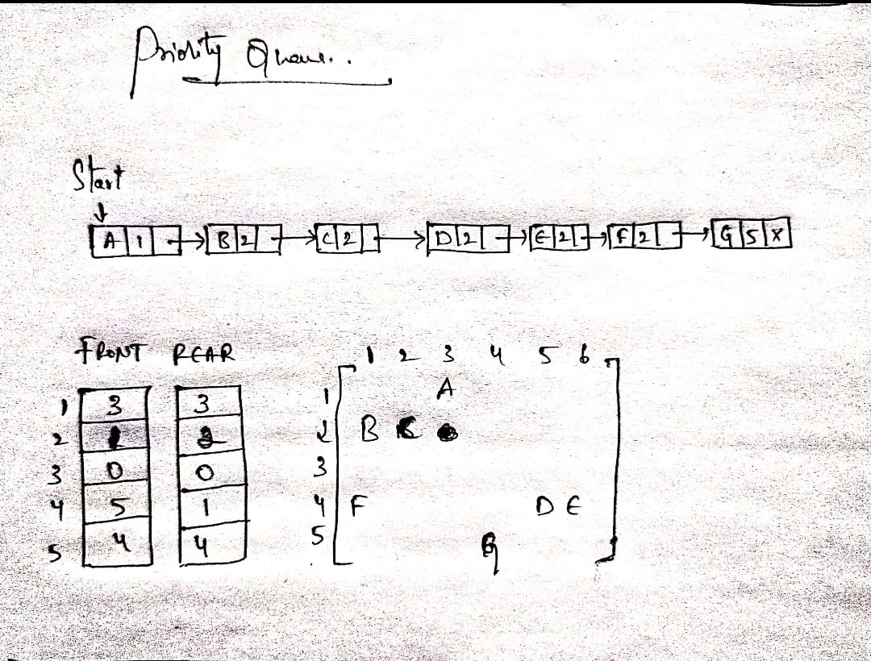
Continue…

Slide 34
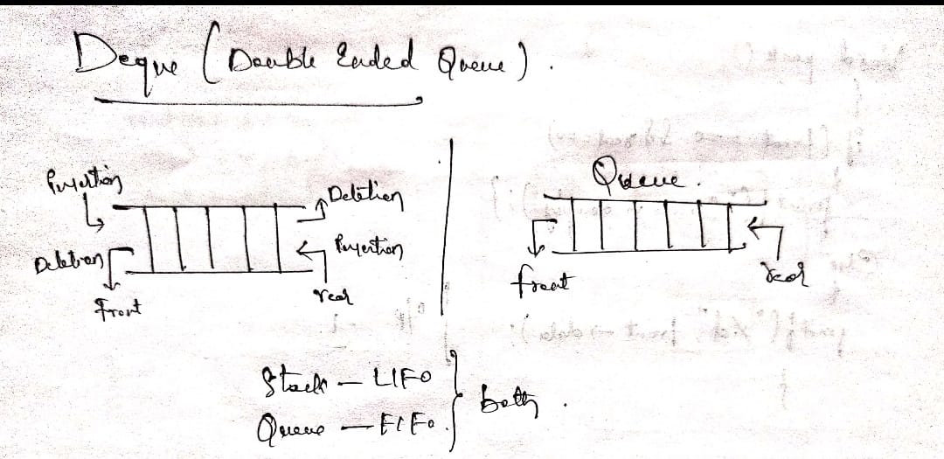
Dequeue (Double Ended Queue)
In Double Ended Queue, insert and delete operation can be occur at both ends that is front and rear of the queue.

Slide 35

Continue…

Slide 36
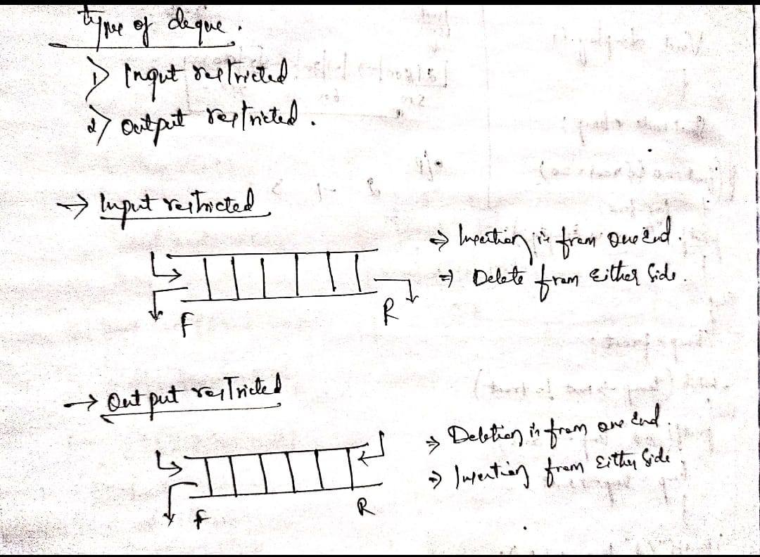
Continue…

Slide 37
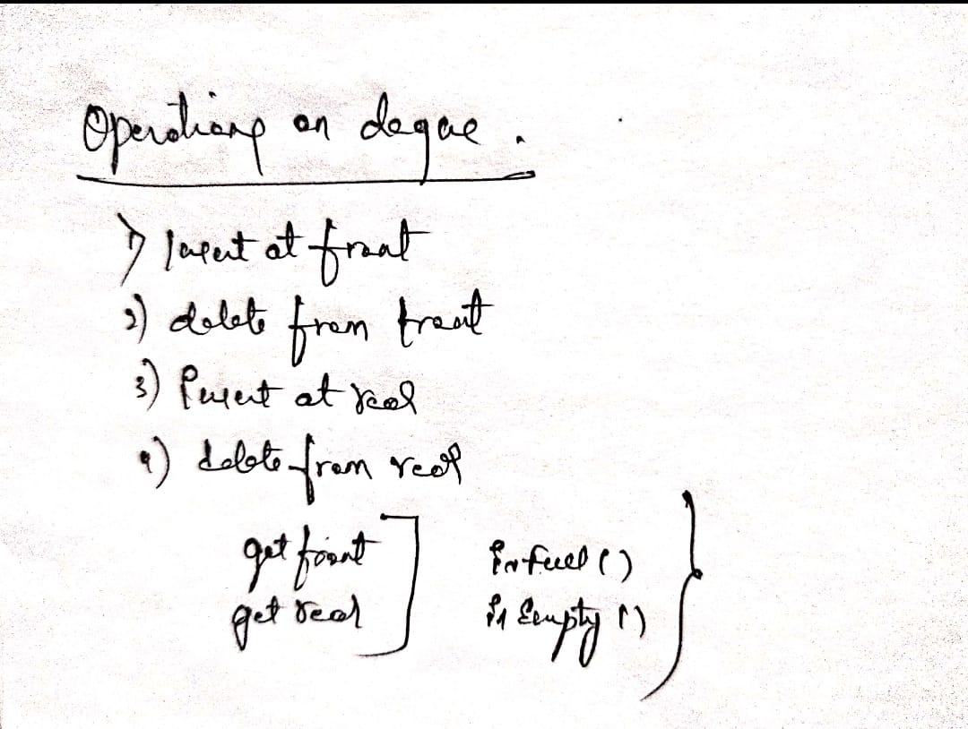
Continue…

Slide 38
Applications of Queue
Queue, as the name suggests is used whenever we need to manage any group of objects in an order in which the first one coming in, also gets out first while the others wait for their turn, like in the following scenarios:
Serving requests on a single shared resource, like a printer, CPU task scheduling etc.
In real life scenario, Call Centre phone systems uses Queues to hold people calling them in an order, until a service representative is free.
Handling of interrupts in real-time systems. The interrupts are handled in the same order as they arrive i.e First come first served.

Slide 39
Continue…
Message Queues – A message queue is a general concept used for communication between processes. Basically a sender sends a message, and if the receiver cannot receive it immediately maybe because it is busy with something or offline, the message instead of dropping off, waits in some kind of a queue, and when the receiver is ready to receive it, the message is consumed or removed from the queue and sent to the receiver. For example, when you send an email, it waits in a queue called the SMTP queue, until the receiver logs into their inbox. Same concept is applied when you send a message to someone who is not online on a social network. Your message waits in some kind of a queue on a server, and when the recipient comes online, it is sent to them.
Process Scheduling – All the processes running on your computer now, first wait in a queue called ready queue, waiting to be executed by your processor. There are various scheduling algorithms that decide which process should be executed next based on certain criteria like priority.
Data Buffers – A buffer implements a queue and is typically used in communication when there is difference between the rate at which data is received and the rate at which it can be processed. For example in video streaming applications, the video is streamed in bursts and stored in a buffer so that even if the network becomes slow for a while, the playback is not interrupted. Say for example the video is playing at 24fps, then the streaming app may store 240 frames in its buffer, so that it can continue playing for the next 10 seconds even if the network is interrupted. The buffer is also used for sequencing frames, ie, if frames come out of order, they are sorted in the buffer before being played. Buffers also used in disk drives, input/output devices and communication over networks.

